Slide 1
Defensive symbionts and me: an unexpected tale about an uneasy alliance
PSS
24/11/22

Slide 2
Outline
Ecology and evolution
Defensive symbionts
Coevolution
What does this all mean?

Slide 3
Outline
Ecology and evolution
Defensive symbionts
Coevolution
What does this all mean?

Slide 4
Outline
Defensive symbionts
Coevolution
What does this all mean?

Slide 5
Ecology
“The here and now”
Host demographics
Infections
Recovery
Vaccination
Other host properties

Slide 6
Ecology
Host demographics
$$β_{P}SP$$
$$ν(N)$$
$$S$$
$$P$$
Infections
$$γP$$
$$bS$$
$$bP$$
$$α_{P}P$$
Recovery
Vaccination
Other host properties

Slide 7
Ecology
Host demographics
$$β_{P}SP$$
$$ν(N)$$
$$S$$
$$P$$
Infections
$$γP$$
$$bS$$
$$bP$$
$$α_{P}P$$
Recovery
Vaccination
Other host properties

Slide 8
Ecology
Host demographics
$$β_{P}SP$$
$$ν(N)$$
$$S$$
$$P$$
Infections
$$γP$$
$$bS$$
$$bP$$
$$α_{P}P$$
Recovery
Vaccination
Other host properties

Slide 9
Ecology
Host demographics
$$β_{P}SP$$
$$ν(N)$$
$$S$$
$$P$$
Infections
$$γP$$
$$bS$$
$$bP$$
$$α_{P}P$$
Recovery
Vaccination
Other host properties

Slide 10
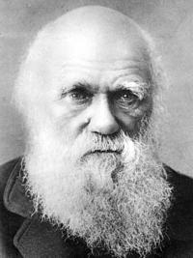
Evolution
This is not what I am talking about:
Instead, we are talking about this guy:

Slide 11
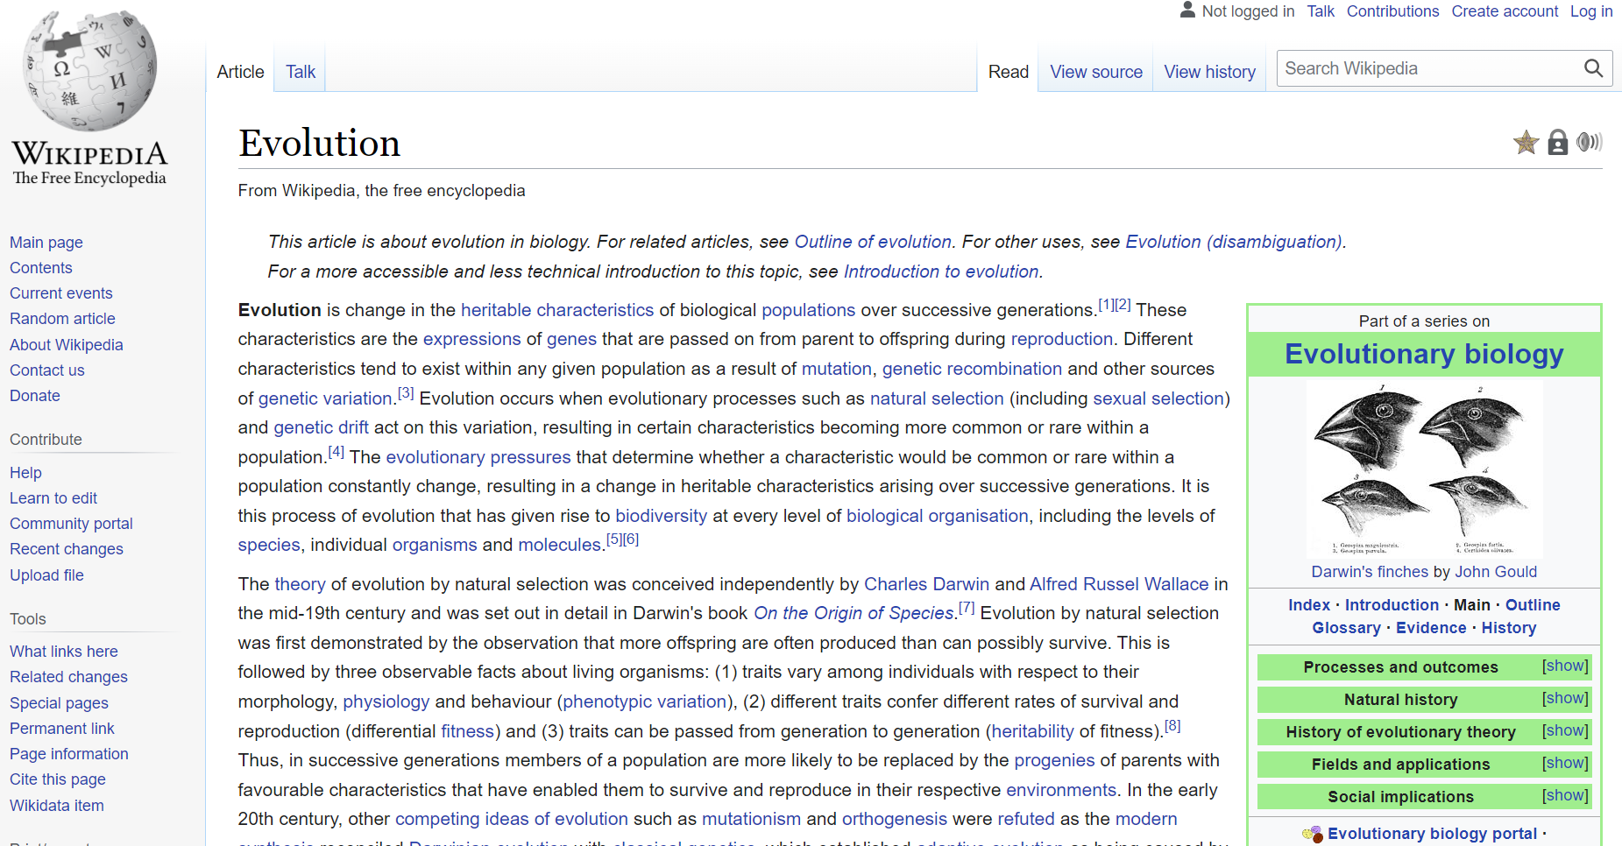
Evolution
What is evolution?

Slide 12
Evolution
What is evolution?

Slide 13
Ecology and evolution: Adaptive dynamics
Simple SI dynamics:
$$\dot{S}=N\left(a−qN\right)−\left[b+β_{P}P\right]S+γP. \\ \dot{P}=\left[β_{P}S −b−α_{P}−γ\right]P.$$
Evolving trait:
Parasite transmission, $β_{P}≥0$.
Trade-off:
Increasing transmission increases virulence, $α_{P}\left(β_{P}\right)$.
Mutant dynamics:
$${\dot{P}}^{m}=\left[β_{P}^{m}S^{∗} −b−α_{P}^{m}−γ\right]P^{m}.$$
Parasite maximises “fitness”:
$$w\left(β_{P}^{m},β_{P}\right)=β_{P}^{m}S^{∗}(β_{P})−b−α_{P}^{m}−γ.$$

Slide 14
Singular strategies and classification
Parasite maximises “fitness”:
$$w\left(β_{P}^{m},β_{P}\right)=β_{P}^{m}S^{∗}(β_{P})−b−α_{P}^{m}−γ.$$
 |  | Convergence stable – can approach through small mutations
 |  | Convergence stable | Not convergence stable
Evolutionary stable – Cannot be invaded by nearby mutants | Evolutionary stable
 | Not evolutionary stable
Singular strategies satisfy: $$0=s\left(β_{P}^{∗}\right)={\left.\frac{∂w}{∂β_{P}^{m}}\left(β_{P}^{m},β_{P}\right)\right|}_{β_{P}^{m}=β_{P}=β_{P}^{∗}}$$
Singular strategies can be classified by looking at different second derivatives of the fitness function

Slide 15
Singular strategies and classification
Parasite maximises “fitness”:
$$w\left(β_{P}^{m},β_{P}\right)=β_{P}^{m}S^{∗}(β_{P})−b−α_{P}^{m}−γ.$$
 |  | Convergence stable – can approach through small mutations
 |  | Convergence stable | Not convergence stable
Evolutionary stable – Cannot be invaded by nearby mutants | Evolutionary stable | Continuously stable strategy | “Garden of Eden”
 | Not evolutionary stable | Branching | Repeller
Singular strategies satisfy: $$0=s\left(β_{P}^{∗}\right)={\left.\frac{∂w}{∂β_{P}^{m}}\left(β_{P}^{m},β_{P}\right)\right|}_{β_{P}^{m}=β_{P}=β_{P}^{∗}}$$
Singular strategies can be classified by looking at different second derivatives of the fitness function

Slide 16
Simulation techniques
$$\dot{S}=N\left(a−qN\right)−\left[b+β_{P}P\right]S+γP. \\ \dot{P}=\left[β_{P}S −b−α_{P}−γ\right]P.$$
Parasite transmission, $β_{P}≥0$.
Increasing transmission increases virulence, $α_{P}\left(β_{P}\right)$.
Set bounds on trait range and discretise.
$β_{P}$
$β_{P,0}$
$β_{P,1}$
$β_{P,2}$
$β_{P,3}$
…
$β_{P,M}$

Slide 17
Simulation techniques
Initialise a small number of infected individuals with a transmission value, e.g. $β_{P}=β_{P,2}$.
Run the ecological dynamics to steady state:
$$\frac{dS}{dt}=N\left(a−qN\right)−\left(β_{P,2}P_{2}+b\right)S+γP_{2} \\ \frac{dP_{2}}{dt}=\left(β_{P,2}S−\left(b+α_{P}\left(β_{P,2}\right)+γ\right)\right)P_{2},$$
with initial condition $\left(S,P_{2}\right)=(\tilde{S},{\tilde{P}}_{2})$.
Introduce a rare mutant at $β_{P,2±1}$ uniformly at random (say $β_{P,1}$ chosen).
4
3
2
Evo Time
1
0
$$β_{P,0}$$
$$β_{P,1}$$
$$β_{P,2}$$
$$β_{P,3}$$
$$β_{P,4}$$
Transmission

Slide 18
Simulation techniques
Introduce a rare mutant at $β_{P, 2±1}$ uniformly at random (say $β_{P,1}$ chosen).
Run the ecological dynamics to steady state: $$\frac{dS}{dt}=N\left(a−qN\right)−\left(β_{P,1}P_{1}+β_{P,2}P_{2}+b\right)S+γP_{1}+γP_{2} \\ \frac{dP_{1}}{dt}=\left(β_{P,1}S−\left(b+α\left(β_{P,1}\right)+γ\right)\right)P_{1}, \\ \frac{dP_{2}}{dt}=\left(β_{P,2}S−\left(b+α(β_{P,2})+γ\right)\right)P_{2},$$
with initial condition $\left(S,P_{1},P_{2}\right)=(S^{∗},ε,P_{2}^{∗})$.
Remove any mutants below a threshold.
Repeat
4
3
2
Evo Time
1
0
$$β_{P,0}$$
$$β_{P,1}$$
$$β_{P,2}$$
$$β_{P,3}$$
$$β_{P,4}$$
Transmission

Slide 19
Outline
Ecology and evolution
Defensive symbionts
Coevolution
What does this all mean?

Slide 20
Outline
Ecology and evolution
Defensive symbionts
Coevolution
What does this all mean?

Slide 21
Outline
Evolution and ecology
Coevolution
What does this all mean?

Slide 22
What is a defensive symbiont?
Defensive symbiont
Devoted to resisting or preventing aggression or attack.
An organism living in symbiosis.
Symbiosis: A cooperative relationship (as between two persons or groups).
Sentence: Cameron is a footballing defensive powerhouse…
Said nobody ever!

Slide 23
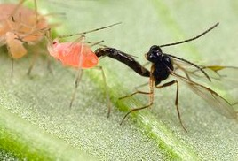
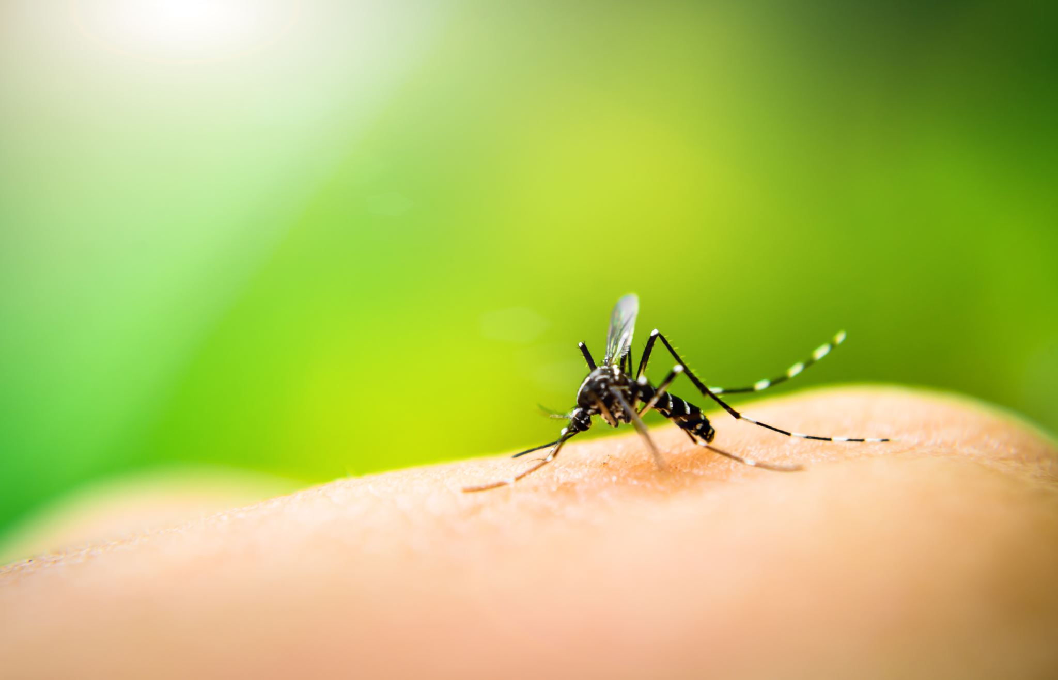
Some examples
Aphid host
Human host
Mosquito
Parasitic wasp
Protective bacteria: Hamiltonella defensa
Protective bacteria: Wolbachia

Slide 24
Types of defence
Tolerance
Resistance

Slide 25
Types of defence
Tolerance shields the host from the harmful effects of the parasite.
Tolerance
Two forms of tolerance – “Fecundity tolerance” and “mortality tolerance”.
Fecundity tolerance prevents new births with the parasite, mortality tolerance reduces virulence.
Resistance

Slide 26
Types of defence
Tolerance shields the host from the harmful effects of the parasite.
Tolerance
Two forms of tolerance – “Fecundity tolerance” and “mortality tolerance”.
Fecundity tolerance prevents new births with the parasite, mortality tolerance reduces virulence.
Resistance
Resistance reduces the rate at which the parasite is transmitted to new hosts.
There are a few experimental organisms which demonstrate resistance.

Slide 27
Outline
Ecology and evolution
Defensive symbionts
Coevolution
What does this all mean?

Slide 28
Outline
Ecology and evolution
Defensive symbionts
Coevolution
What does this all mean?

Slide 29
Outline
Evolution and ecology
Defensive symbionts
What does this all mean?

Slide 30
Meet the characters for today
Pathogen registration form
Pathogen registration form
Name:
Type:
Philosophy:
Name:
Type:
Philosophy:
Subject #796
Subject #727

Slide 31
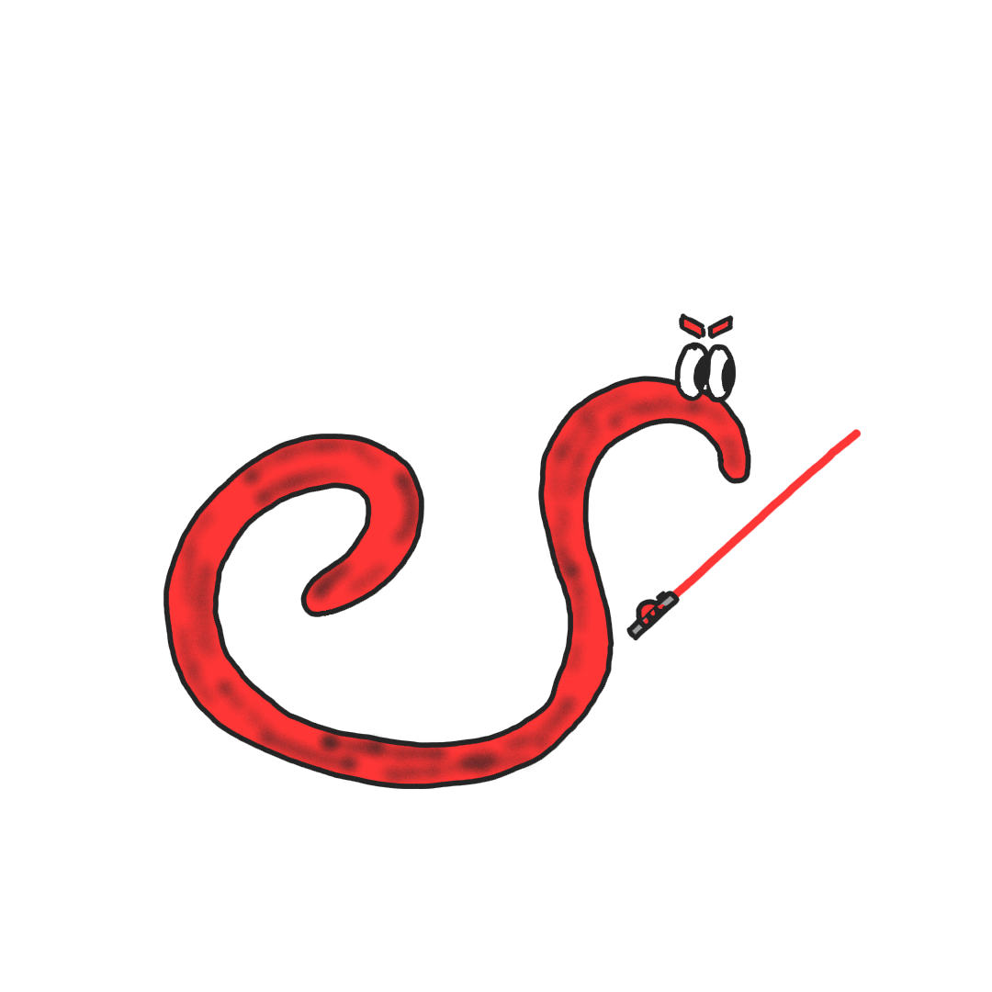
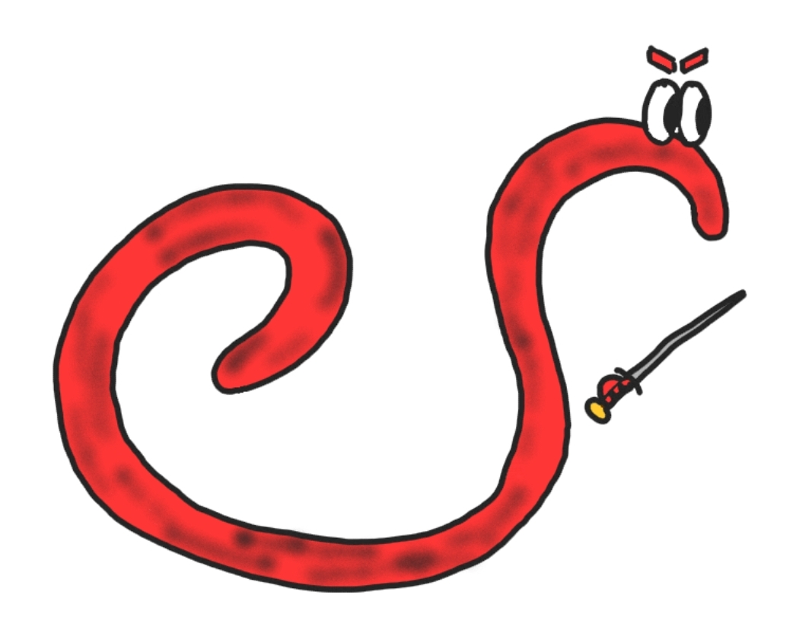
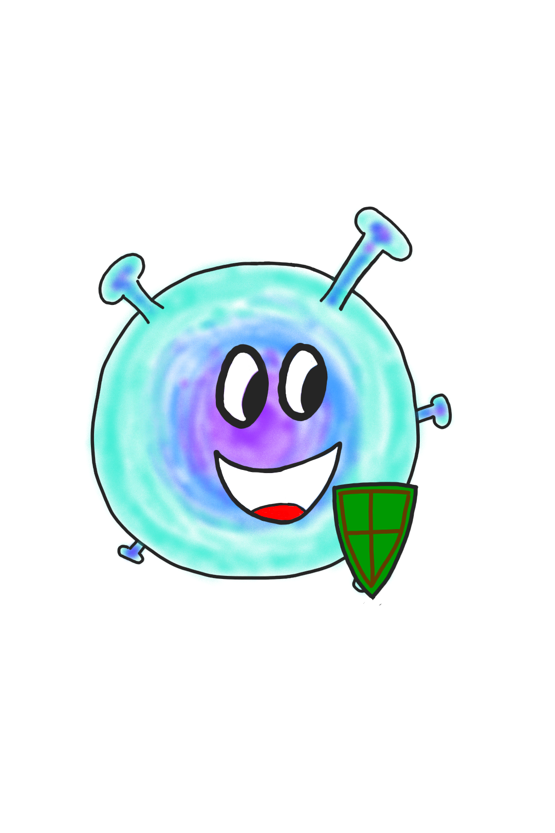
Coevolution
The response and counter-response between more than one organism.
We want to see how a defensive symbiont affects the host-parasite interaction.

Slide 32
Coevolution: Ecological dynamics
Blue: Births
Green: Transmission
Red: Deaths
Yellow: Recovery

Slide 33
Coevolution: Evolutionary dynamics
Evolving parameters
“Effort”
$$y∈(0,1)$$
Transmissibility
$$β_{P}>0$$
Protection
Trade-offs
$$β_{D}\left(y\right)$$
$$α_{P}(β_{P})$$
Mortality tolerance
$$α_{B}\left(y,β_{P}\right)=α_{D} \\ +\left(1−y\right)α_{P}(β_{P})$$
$$y$$
$$β_{P}$$

Slide 34
Audience participation time!
Imagine that you work in a lab, and you are tasked with creating a defensive symbiont to release into a population of hosts.
You have the ability to decide the level to which it initially helps the host, i.e. you can choose $y∈\left(0,1\right)$, where $y=0$ corresponds to no help and maximal transmission, and $y=1$ is maximum help but minimal transmission.
Where do you initialise?

Slide 35
Audience participation time!
Imagine that you work in a lab, and you are tasked with creating a defensive symbiont to release into a population of hosts.
You have the ability to decide the level to which it initially helps the host, i.e. you can choose $y∈\left(0,1\right)$, where $y=0$ corresponds to no help and maximal transmission, and $y=1$ is maximum help but minimal transmission.
Where do you initialise?
A
B
C
D
E
$$y=0$$
$$y=0.25$$
$$y=0.5$$
$$y=0.75$$
$$y=1$$

Slide 36
Outline
Ecology and evolution
Defensive symbionts
Coevolution
What does this all mean?

Slide 37
Outline
Ecology and evolution
Defensive symbionts
Coevolution
What does this all mean?

Slide 38
Outline
Evolution and ecology
Defensive symbionts
Coevolution

Slide 39
Otherwise known as: results
1. Defensive symbionts that confer tolerance always select for higher virulence.
2. Defensive symbionts can drive parasite diversity.
3. Symbiont-parasite coevolution can be detrimental to the host population.

Slide 40
Otherwise known as: results
1. Defensive symbionts that confer tolerance always select for higher virulence.
2. Defensive symbionts can drive parasite diversity.
3. Symbiont-parasite coevolution can be detrimental to the host population.

Slide 41
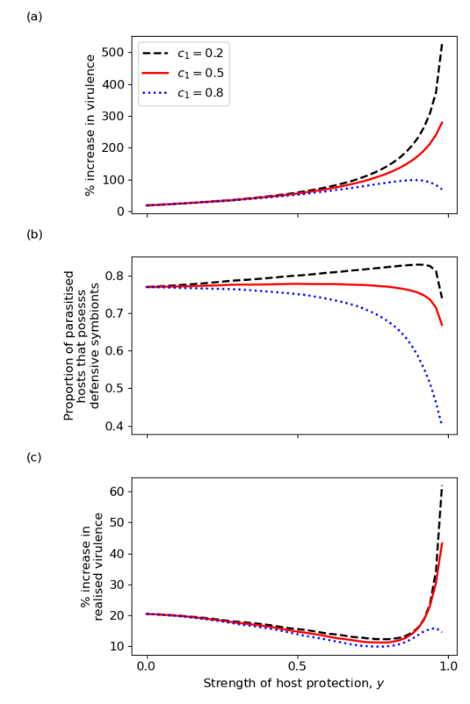
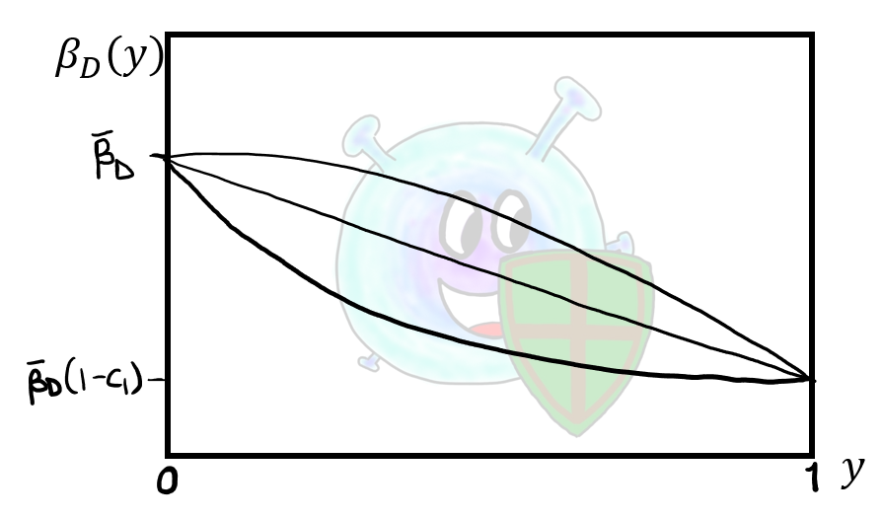
Otherwise known as: results
1. Defensive symbionts that confer tolerance always select for higher virulence.
Not evolving
Evolving
2. Defensive symbionts can drive parasite diversity.
3. Symbiont-parasite coevolution can be detrimental to the host population.

Slide 42
Otherwise known as: results
1. Defensive symbionts that confer tolerance always select for higher virulence.
Not evolving
Evolving
2. Defensive symbionts can drive parasite diversity.
3. Symbiont-parasite coevolution can be detrimental to the host population.

Slide 43
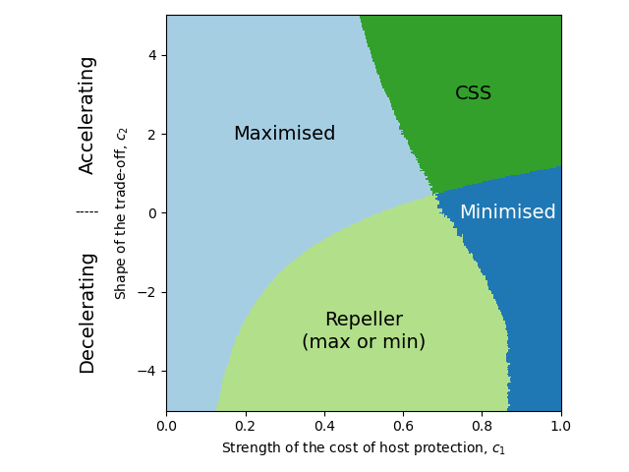
Otherwise known as: results
1. Defensive symbionts that confer tolerance always select for higher virulence.
Evolving
Evolving
2. Defensive symbionts can drive parasite diversity.
3. Symbiont-parasite coevolution can be detrimental to the host population.

Slide 44
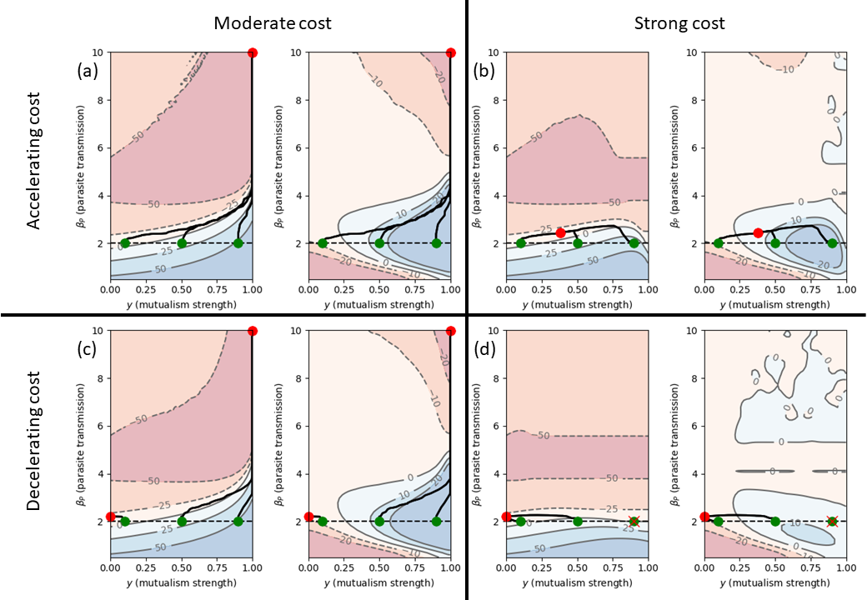
Otherwise known as: results
1. Defensive symbionts that confer tolerance always select for higher virulence.
2. Defensive symbionts can drive parasite diversity.
3. Symbiont-parasite coevolution can be detrimental to the host population.

Slide 45
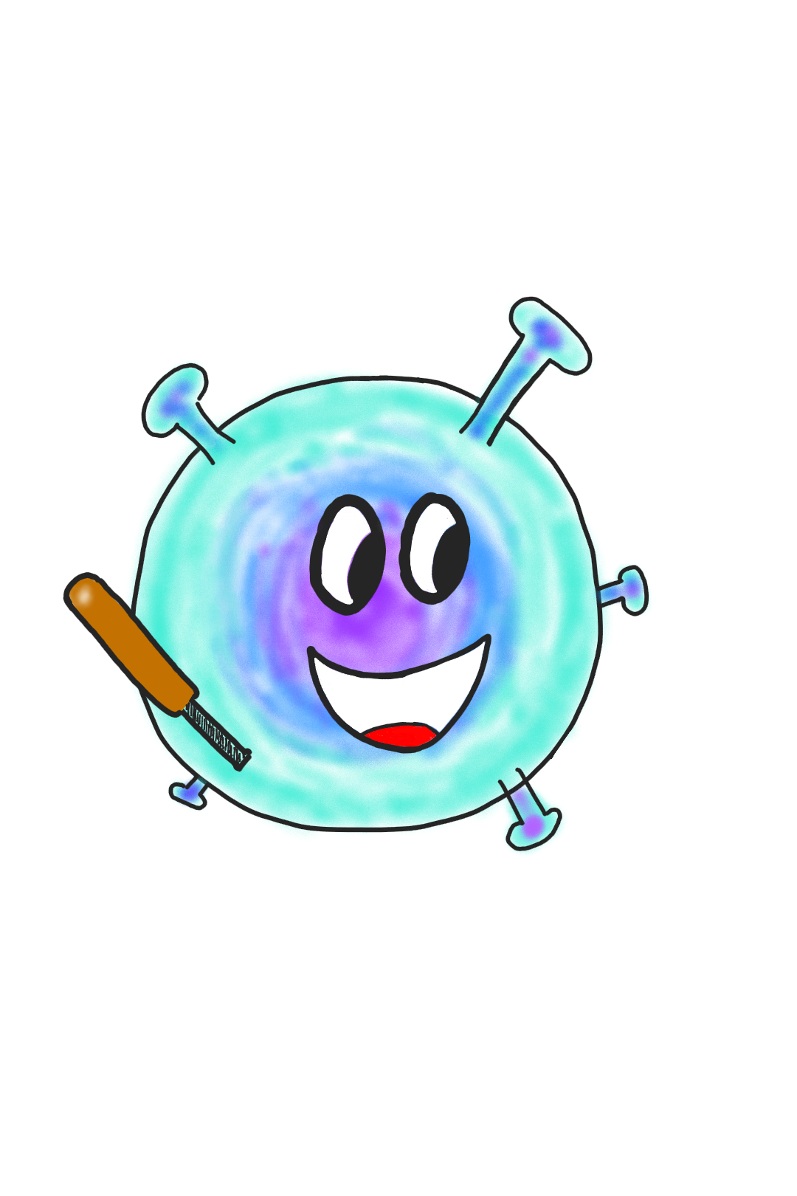
Discussion

Slide 46
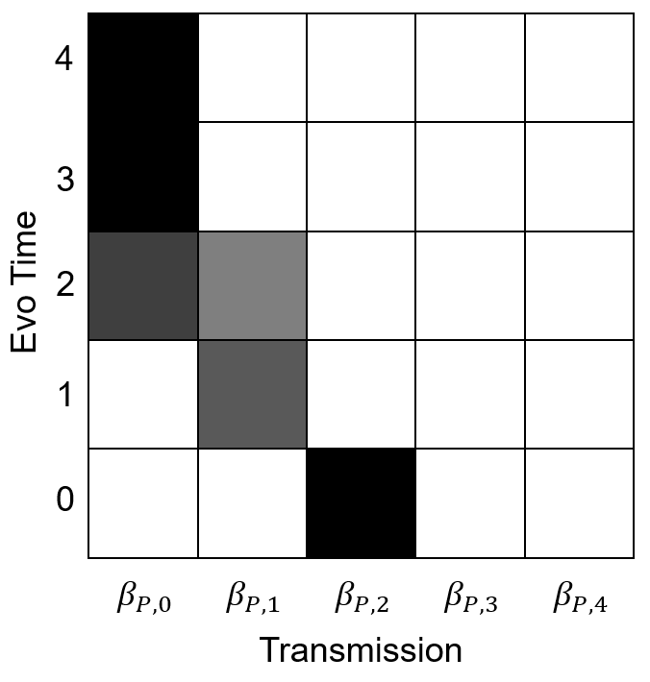
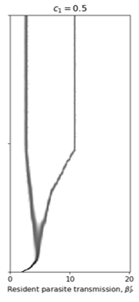
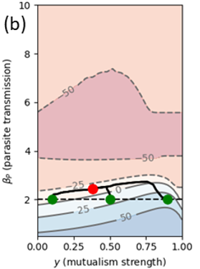
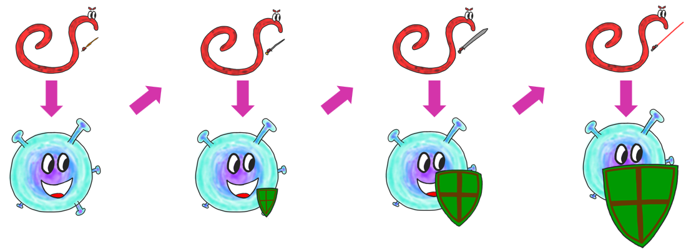
Conclusions
Ecology and Evolution
Defensive symbionts
Coevolution
Results

Slide 47
Thank you!
Joint work with Ben Ashby, who left me for SFU.
Any questions?
I am funded by Natural Environment Research Council grant NE/V003909/1.

